Slide 1
Lecture 11 Hydrogen production Part 2

Slide 2
COAL GASIFICATION
During gasification, the coal is blown through with oxygen/air and steam/water vapour
while also being heated (and in some cases pressurized)
If the coal is heated by external heat sources the process is called "allothermal", while "autothermal" process assumes heating of the coal via exothermal chemical reactions occurring inside the gasifier itself
The produced gas is known as producing syngas which is a mixture of CO, H2, C02, CH4, and water vapour By-products like tar, phenols, etc. are also produced, depending on the specific gasification technology utilized and quality of coal
For low-grade coals (brown coals) which contain significant amounts of water, there are technologies in which no steam is required during the reaction, with coal (carbon) and oxygen being the only reactants

Slide 3
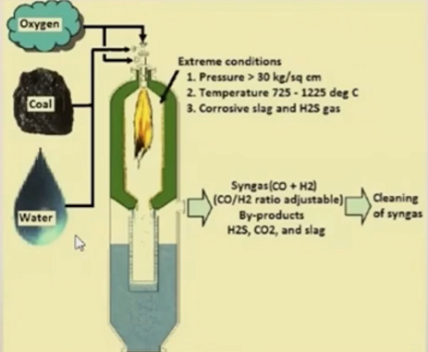
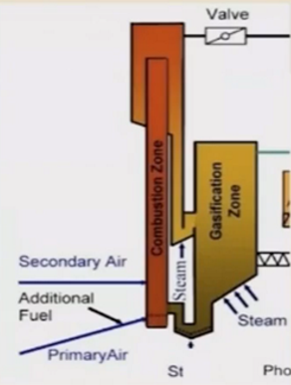
Coal Gasifiers: Autothermal & allothermal
Drawbacks of Allothermal Process
Higher capital cost
Complex system
Low gas pressure
Lower efficiency
Autothermal
Autothermal

Slide 4
DESULPHURISATION PROCESS
• Two types:
• Chemical reaction technologies
Hydro-desulphurisatiorV (HDS), Bio-
(BDS), Oxidative- desulphurisation
desulphurisation (ODS) and Alkylation
Adsorptive technologies
Metals or high surface area materials
such as Molecular Organic Framework,
Zeolites etc. are used

Slide 5
COMPARISON OF DESULPHURISATION PROCESS
Hydro-desulphurisation | Bio-desulphurisation | Oxidative- desulphurisation | Alkylation | Adsorptive methods
• High temperature (300C) • High Pressure (20— 100 atm) Requires H2 feed • Widely used | • Poor kinetics & Enzymes are thermally unstable Low temperature Low pressure | • Low efficiency Requires oxidative agent | Requires costly solvent Low temperature Low pressure | • Ambient pressure and temperature • Needed adsorptive materials

Slide 6
REFORMING PROCESS
• Generally performed after desulphurisation and cleansing
processes
• The product: Syngas (H2 + CO)
• Three major types of reformation processes are:
Steam reforming (SR)
Partial oxidation (POX)
Autothermal reforming (ATR)

Slide 7
STEAM METHANE REFORMING (SMR)
Widely used process for generation of Hydrogen (almost 95%)
Methane (CH4), basically called as NG, is used as feed
In SMR, methane reacts with steam under 3-25 bar pressure
Hydrogen produced by SMR is termed 'grey hydrogen' when the waste carbon
dioxide is released to the atmosphere
Termed as 'blue hydrogen' when the carbon dioxide is captured and sequestrated
SMR efficiency is around 65-75%
This process is endothermic i.e., heat generated during reaction
Feed materials used: Natural gas (methane), Liquid gas, Naphtha or gasification by
products from coal/biomass
The desulfurized hydrocarbon feed is mixed with superheated steam distributed
on the catalyst-filled reformer tubes. Catalyst used: Ni, Rh, Pt etc.

Slide 8
HYDROGEN PRODUCTION METHODS
Hydrogen Production Methods
Fossil Fuel
Renewable Sources
Hydrocarbon Reforming
Hydrocarbon Pyrolysis
Biomass Process
Water Splitting
Steam Reforming
Partial Oxidation
Autothermal Reforming
Thermolysis
Photolysis
Electrolysis
Green H2
Alkaline
Solid Oxide
PEM
Biological
Thermochemical
Bio-photolysis
Dark Fermentation
Photo Fermentation
Gasification
Pyrolysis
Combustion
Liquefaction

Slide 9
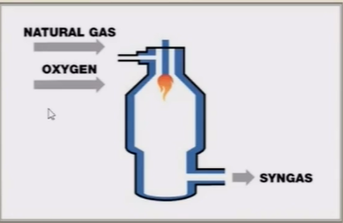
PARTIAL OXIDATION (POx) METHODS
Limited amount of oxygen (typically from air) is used here, such that complete oxidation (to form C02) is not possible
With less than the stoichiometric amount of 02 available, the reaction products contain primarily hydrogen (H2) and carbon monoxide (CO)
POX is an exothermic process
Catalyst is used often to lower down the temperature and the processes known as Catalytic pox or CPOX

Slide 10
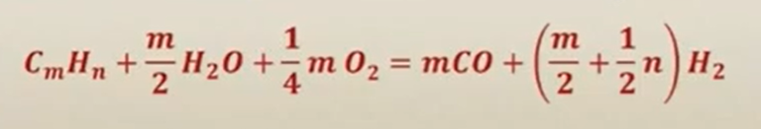
AUTOTHERMAL REFORMING (ATR)
• This process is combination of SMR & POX
• The exothermic SMR provides the heat for POX
• Firstly, methane is introduced with steam and then the produced gas is introduced to catalytic bed for POX
• The feedstock for ATR can be natural gas, pre-reformed gas, Liquefied Petroleum Gas (LPG) or naphtha

Slide 11
WATER GAS SHIFT (WCS) REACTION
The syngas produced after reforming consists of CO + H2
The produced syngas is further introduced to WGS reactors to increase the H2 amount
CO + H20 (steam) C02 + H2
The reactors are generally combination of a high temperature
reactor and a low temperature reactor
The high temperature (>3500C) reactor has fast kinetics but is
limited by thermodynamics to the amount of carpon monoxide
that can be converted
Therefore, a lower temperature reactor (210—3300C) is used to
higher conversion of carbon monoxide
HT WGS reactor uses Fe catalyst & LT HGS reactor uses Cu catalyst

Slide 12
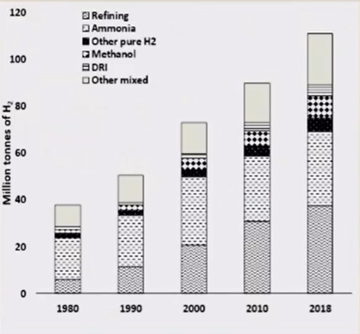
GLOBAL HYDROGEN PRODUCTION

Slide 13
Thank you

